Slide 1
Office macro classifier
מגיש: דניאל ריבני

Slide 2
office macros
Office Macros: Automated scripts in office software streamline tasks.
Security Risks: Malicious macros can install malware or steal data.
Phishing Attacks: Cybercriminals use macros in email attachments to execute harmful actions.
Vulnerabilities: Outdated software exposes systems to macro-based attacks.

Slide 3
solution approach
In my approach, I experimented with multiple algorithms to train the model, aiming to achieve the highest possible accuracy while minimizing both false positives and false negatives within the classifier. In the following slides, I will present the algorithms I explored along with their corresponding accuracy scores, precision values, and confusion matrices.

Slide 4

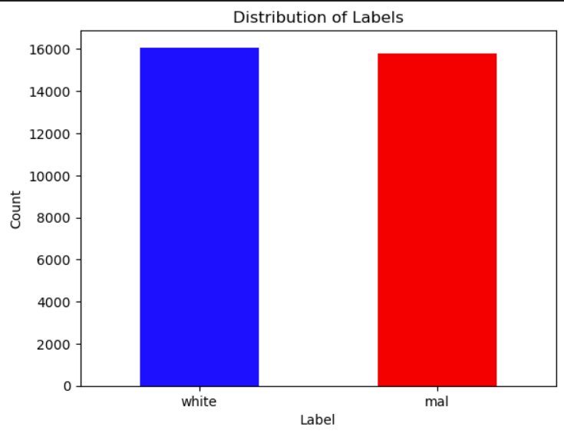
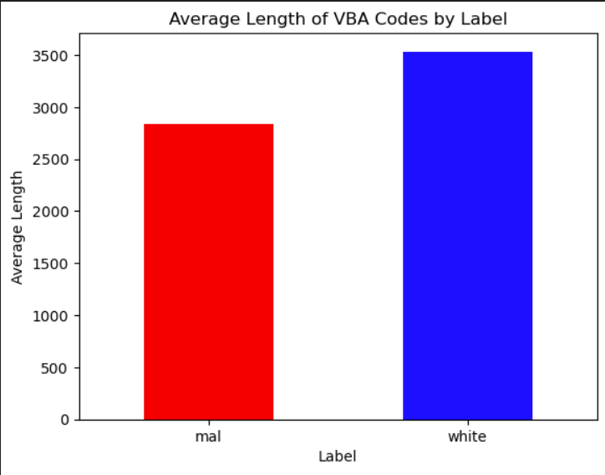
Data exploration
About the same number of white and malicious VBA codes.
In average, the white VBA codes were longer than the malicious ones.

Slide 5
Tf-idf
TF-IDF, or Term Frequency-Inverse Document Frequency, is a numerical statistic used in information retrieval and text mining to measure the importance of a word in a document relative to a collection of documents. It represents the frequency of a term in a document (TF) normalized by the frequency of the term across all documents (IDF).
I used for all the algorithms the following values:
ngram_range(1,3) : Specifies the range of n-grams (contiguous sequences of n items) to consider for TF-IDF vectorization
stop_words('english’) : Removes common words that carry little meaning or relevance from the document before TF-IDF calculation.
max_features(100000) : Limits the number of features (unique words or n-grams) to consider in the TF-IDF matrix, keeping only the most frequent ones.
sublinear_tf(True): Applies a logarithmic transformation to the term frequencies to mitigate the impact of document length on TF-IDF scores.
min_df(5) : Specifies the minimum document frequency threshold, ignoring terms that appear in fewer documents than this threshold.
smooth_idf(True) : Adds a constant to the document frequency of terms to avoid division by zero and ensure stability in IDF calculation.
Norm('l2’) : Normalizes the TF-IDF vectors to unit length to alleviate the effect of document length variation on similarity measures.

Slide 6
Gradient Boosting Classifier
Gradient Boosting Classifier is an ensemble learning technique used for classification tasks, particularly in structured/tabular data. It builds a strong predictive model by combining multiple weak learners, typically decision trees, sequentially. Each new learner focuses on correcting the errors made by the previous ones, leading to improved accuracy.

Slide 7
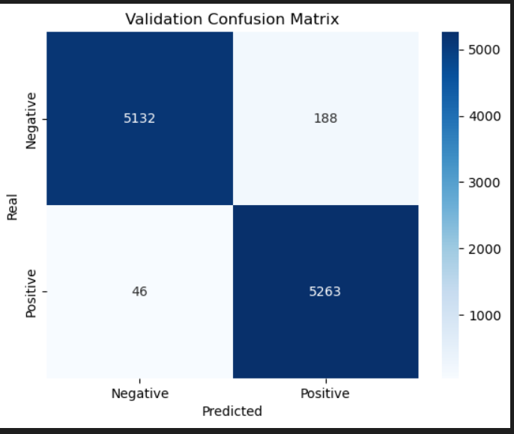
Gradient Boosting Classifier results
Accuracy 0.9779847586790855.
precision 0.9655.
False positive 188.
False negative 46.

Slide 8
Logistic Regression
Logistic Regression is a supervised learning algorithm used for binary classification tasks. It models the probability that a given input belongs to a particular class using the logistic function. The algorithm learns a linear decision boundary that separates the classes in feature space. Despite its name, Logistic Regression is primarily used for classification rather than regression tasks.

Slide 9
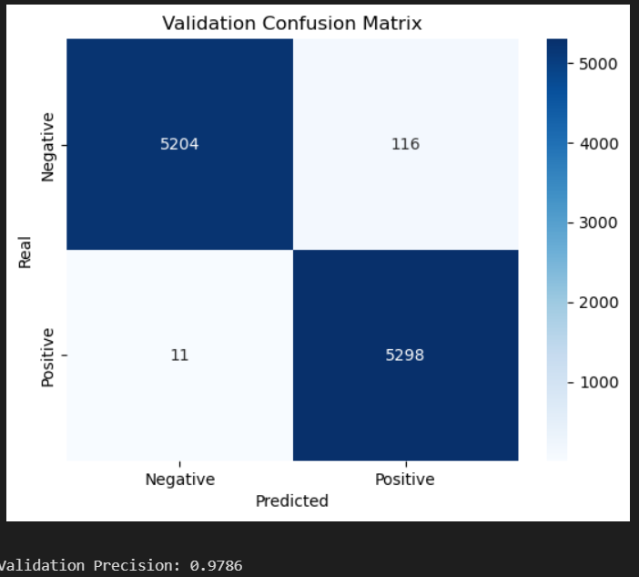
Logistic Regression results
Accuracy 0.9880515570608712.
Precision 0.9786.
False positive 116.
False negative 11.

Slide 10
Support Vector Classifier (SVc)
Support Vector Classifier (SVC) is a supervised machine learning algorithm used for classification and regression tasks. It works by finding the hyperplane that best separates the data points into different classes or predicts the continuous target variable. SVC aims to maximize the margin, the distance between the hyperplane and the closest data points from each class. It can handle both linear and non-linear data by using different kernel functions

Slide 11
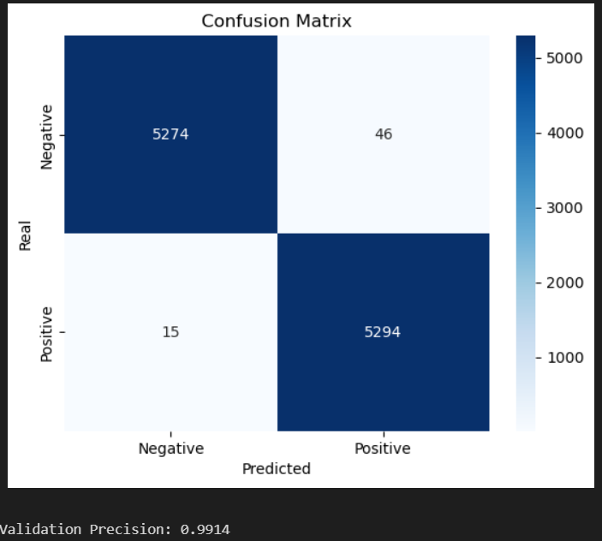
Svc results
Accuracy 0.9942609841001034.
Precision 0.9914.
False positive 46.
False negative 15.

Slide 12
Random Forest
Random Forest is an ensemble learning method used for both classification and regression tasks. It constructs a multitude of decision trees during training and outputs the mode (for classification) or average prediction (for regression) of the individual trees. Each tree is built using a random subset of features and training data, ensuring diversity among the trees

Slide 13
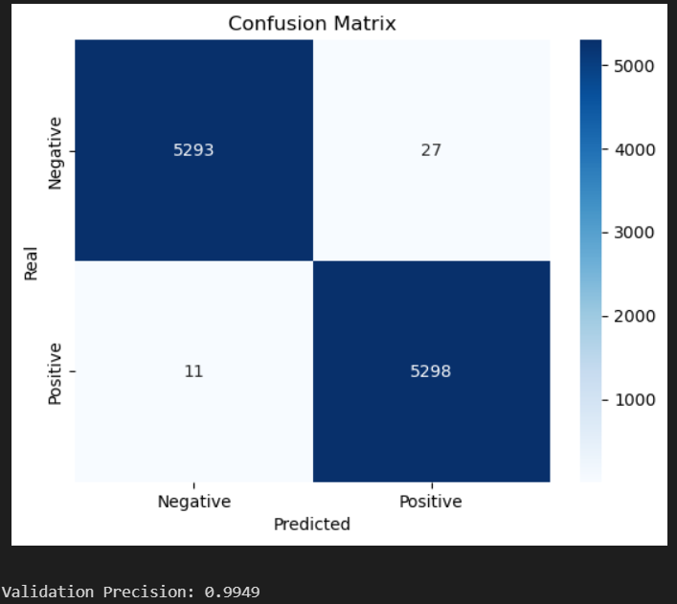
Random Forest results
Accuracy 0.9964248753410481.
Precision 0.9949.
False positive 27.
False negative 11.
With default settings

Slide 14
Select K Best
“Select k best” is a feature selection technique used in machine learning to choose the top k most informative features from a dataset based on statistical tests. It evaluates each feature individually and selects those with the highest scores.

Slide 15
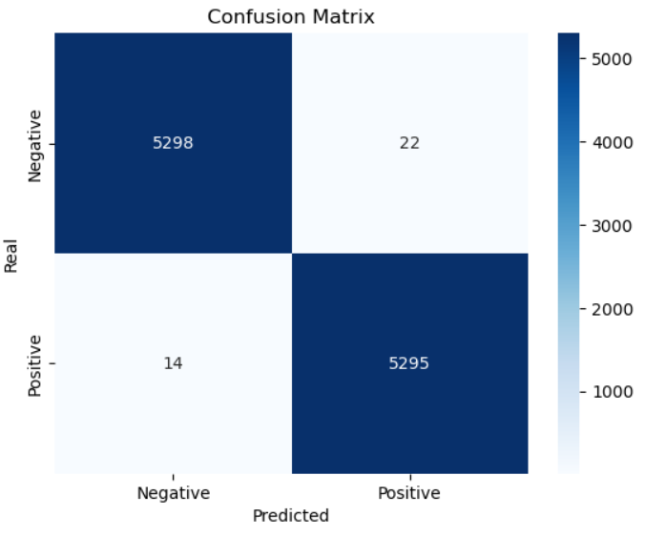
Random Forest with select k best
Features values:
n_estimators (100) : Number of decision trees to be created in the random forest.
Criterion ('entropy’) :The function to measure the quality of a split.
max_depth (None) : Maximum depth of the decision trees in the random forest.
min_samples_split (2) : Minimum number of samples required to split a node in a decision tree.
min_samples_leaf (1) : Minimum number of samples required to be at a leaf node in a decision tree.
max_features (sqrt) : The maximum number of features to consider when looking for the best split.
Bootstrap (True) : Whether samples are drawn with replacement for each tree in the random forest.
random_state (42) : Seed for random number generation to ensure reproducibility.
class_weight (None) : Weights associated with classes to handle class imbalance.
oob_score (False) : Whether to use out-of-bag samples to estimate the generalization accuracy.
Accuracy: 0.9966130397967824.
Precision 0.9959.
False positive 22.
False negative 14.
With K= 3500 features.

Slide 16
In conclusion
After experimenting with various algorithms, I found that the "Random Forest" algorithm produced the best results. To enhance its performance further and reduce false positives and negatives, I incorporated hyperparameters. Comparing the results, the classifier with hyperparameters showed slight improvement over the one without but using the select k best improve the model significantly. Utilizing hyperparameters was challenging as it involved adjusting numerical values, yet it ultimately led to better and more accurate outcomes.

